Slide 1
Problem statement : IOT in Healthcare: Remote patient monitoring using IOT.
Team Name : GEAR 5
College Name : Panimalar Engineering College

Slide 2
Team members Name | Mail id | Team faculty mentors | Mail id
RASHWANTH R | rashwanth89@gmail.com | Dr. Bhuvaneshwari | buvanrajan16@gmail.com
THAZEEM M D | yusufthazeem@gmail.com | Dr. Bhuvaneshwari | buvanrajan16@gmail.com
SYED THAMEEMUDDIN M R | syxdthameem@gmail.com | Dr. Bhuvaneshwari | buvanrajan16@gmail.com
Team details
Team Name – GEAR 5 Team No – TEAM195 College Name - Panimalar Engineering College

Slide 3
PROBLEM STATEMENT DETAILING
There is a growing need for continuous health monitoring in patients and individuals with chronic conditions. Our objective is to develop a system that combines sensor data and camera-based movement detection to detect unusual activity and improve patient outcomes
The healthcare sector faces challenges in continuous patient monitoring, especially in environments like hospitals and remote care settings. The absence of real-time monitoring systems that can track both health parameters and physical movement increases the risk of undetected emergencies, such as falls, seizures, or other critical events.

Slide 4
SOLUTION
The goal of this project is to develop an advanced IoT-based healthcare monitoring system that integrates camera-based patient movement analysis using Computer Vision, along with standard health metrics monitoring, and also maintain the environmental conditions to enhance patient safety and provide real-time alerts for Health care professionals.
The Technology stack used here are Python, C++, Computer Vision, ThingSpeak, IFTTT.
Impact and Benefits:
Enhanced Patient Safety: Continuous monitoring helps reduce the response time to medical emergencies, preventing critical events like falls from going unnoticed.
Improved Caregiver Assistance: Caregivers are empowered with real-time data and alerts, enabling them to act swiftly in emergencies.
Proactive Healthcare: Predictive insights enable early detection of health risks, facilitating proactive healthcare interventions.

Slide 5
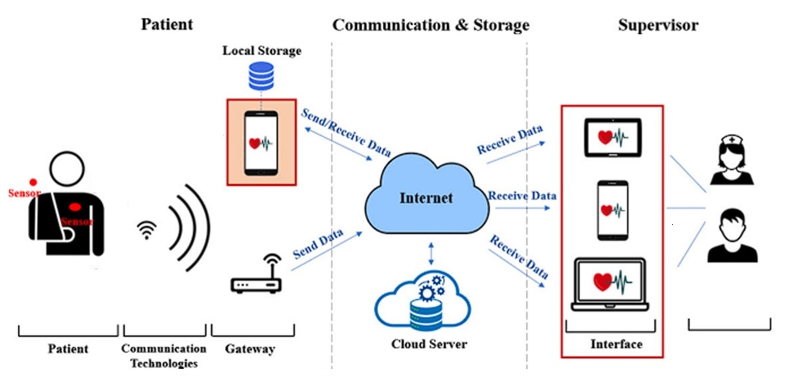
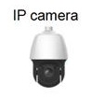
Architecture Diagram

Slide 6
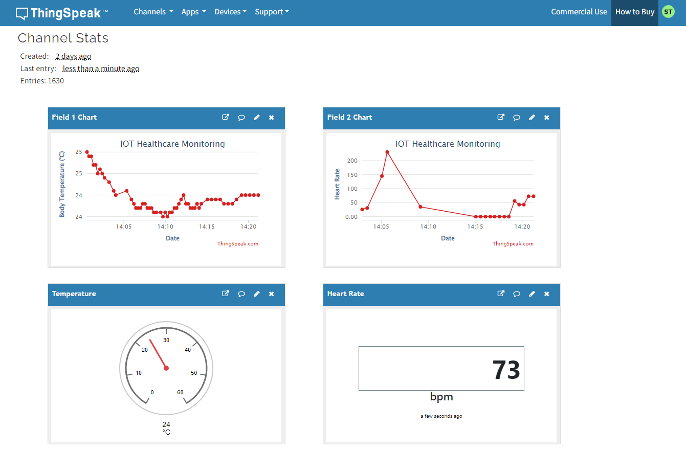
User Interface

Slide 7
Unique Features And Advantages
Real-Time Monitoring and Alerts:Continuous data collection from health sensors (e.g., temperature, heart rate) and cameras allows for real-time monitoring of patient health.Immediate alerts can be triggered in response to abnormal readings or detected movements (e.g., falls, heart rate fluctuation).
Improved Patient Safety:With ComputerVision detecting movement and falls, the system can prevent injuries by notifying caregivers instantly, ensuring quick intervention.Health trends and anomalies can be analyzed in real-time to anticipate potential health issues.
Cloud Integration for Advanced Analytics:The cloud layer stores data and runs AI/ML algorithms to perform deeper analysis, such as detecting health trends, generating reports, and offering predictive healthcare insights.Centralized storage in the cloud ensures that the data is securely available for caregivers and healthcare providers from any location.

Slide 8



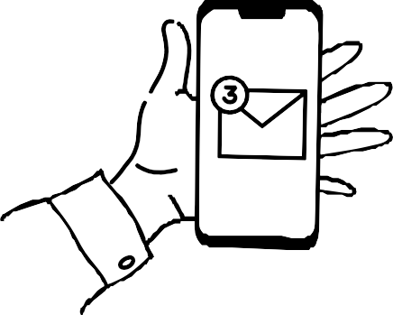
System Overview
ESP32 Microcontroller: Acts as the brain of the system, reading sensor data and communicating with the cloud.
Heart Rate Sensor (MAX30100/MAX30102): Measures the patient’s heart rate in real-time.
ThingSpeak Cloud: A cloud platform for IoT data storage and visualization. Heart rate data is stored here and monitored remotely.
IFTTT (If This Then That): A service that triggers alerts (SMS or email) when heart rate exceeds a predefined threshold.

Slide 9

Results and Testing
The heart rate data is displayed in real-time on ThingSpeak's dashboard as a continuous graph. You can visually monitor the trends and check if the heart rate exceeds a threshold.
When the heart rate goes above 100 bpm, an SMS or email alert is sent through IFTTT to notify the healthcare provider or family member. This system was tested using simulated data where the heart rate was manually set to exceed the threshold.

Slide 10
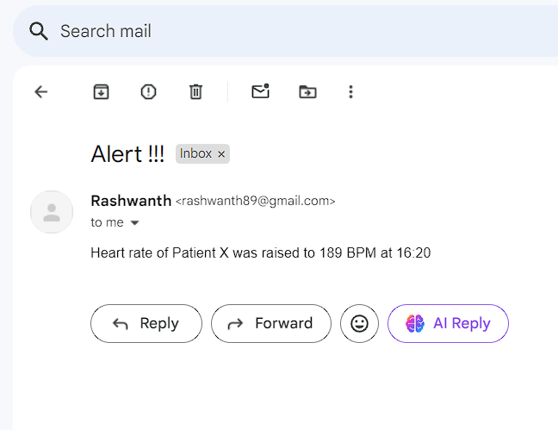
ALERTS
FTTT sends an SMS or email alert when a patient's heart rate exceeds the critical threshold, ensuring real-time monitoring. The alert message, like "Heart Rate Alert! Patient’s heart rate exceeds 100 bpm," is sent directly to caregivers' devices

Slide 11
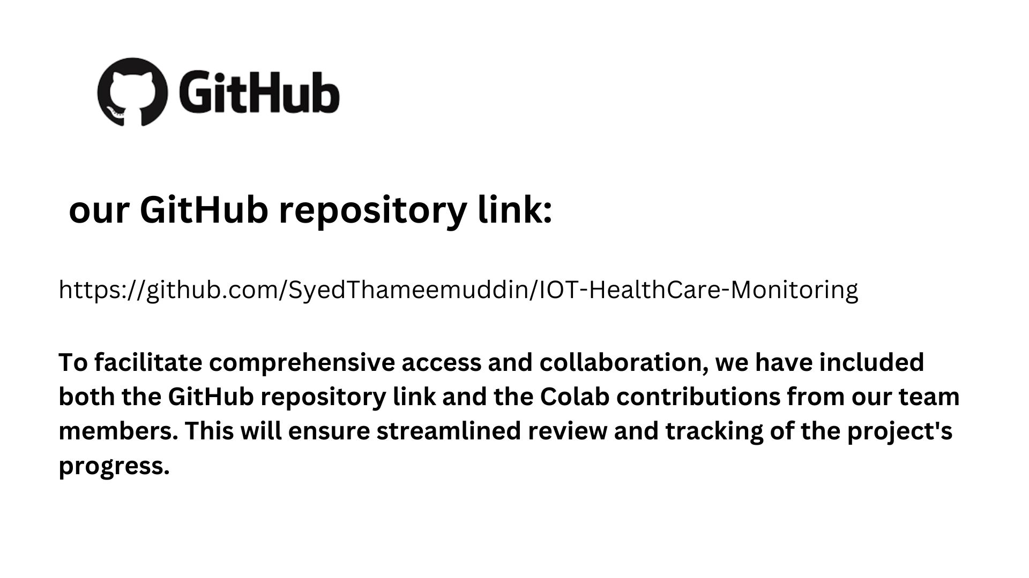

Slide 12
CONCLUSION:
The proposed IoT-based remote patient monitoring system offers a comprehensive solution for continuous healthcare monitoring. By integrating real-time data collection, predictive analytics, and emergency alerts, the system enhances patient care, reduces hospital visits, and provides timely interventions. This solution aims to improve overall healthcare efficiency and patient outcomes, making it a strong contender for innovation in healthcare technology.

Slide 13
THANK YOU!!
Presented by team ”GEAR 5“

